Slide 1
Comment Toxicity Detection
Presented by
Priyadharshini S

Slide 2
AGENDA
Objective
Business Use Cases
Data Exploration & Preparation
Model Building (LSTM & CNN)
Evaluation Metrics & Comparison
Deployment

Slide 3
OBJECTIVE
Online communities and social media platforms have become integral parts of modern communication, facilitating interactions and discussions on various topics. However, the prevalence of toxic comments, which include harassment, hate speech, and offensive language, poses significant challenges to maintaining healthy and constructive online discourse. To address this issue, there is a pressing need for automated systems capable of detecting and flagging toxic comments in real-time.
Business Use Cases:
Social Media Platforms
Online Forums and Communities
Content Moderation Services
Brand Safety and Reputation Management
E-learning Platforms and Educational Websites
News Websites and Media Outlets

Slide 4
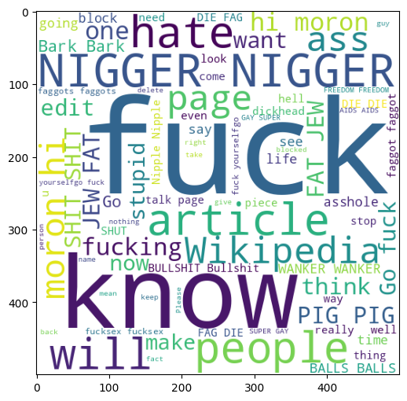
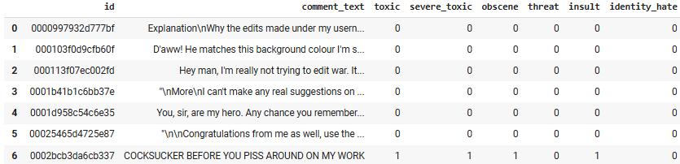
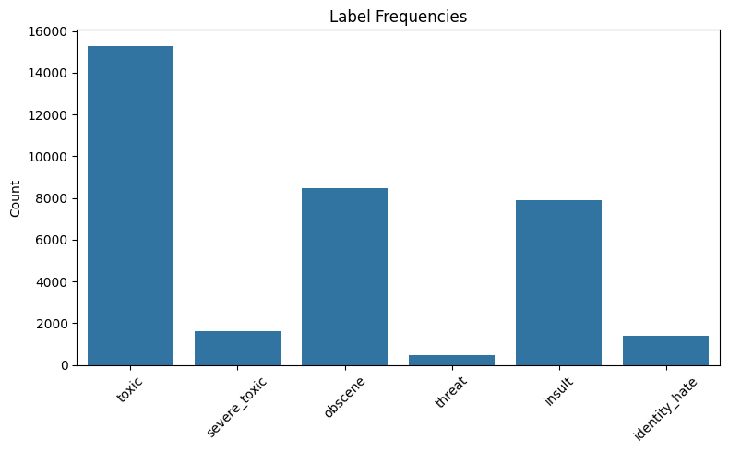
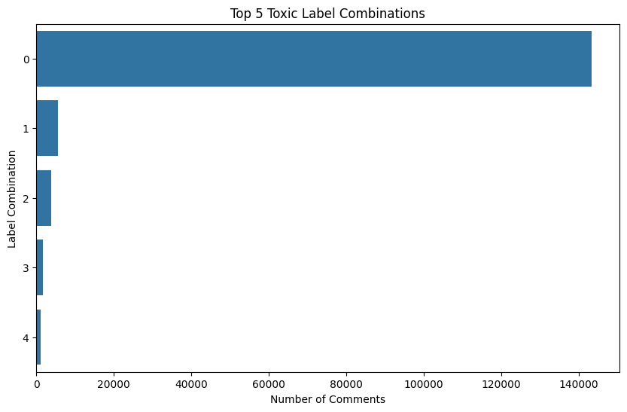
Dataset Exploration & Preparation

Slide 5
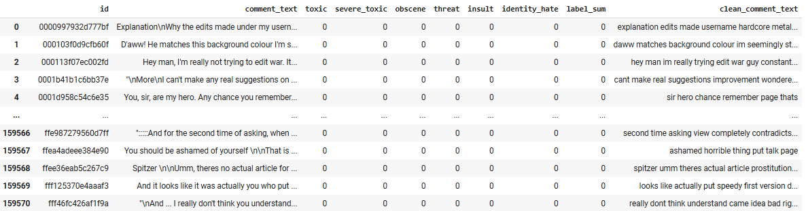
Dataset Exploration & Preparation
Natural Language Processing (NLP) is a branch of artificial intelligence (AI) concerned with the interaction between computers and human language. The main goal of NLP is to enable computers to read, understand, interpret, and generate human (natural) language in a way that is both valuable and meaningful.
Fundamentals:
Tokenization is the process of breaking down text into smaller pieces called tokens.
Stopword removal involves eliminating common words that are usually considered unimportant for text analysis, such as “the”, “is”, “at”, “and”, etc.
Vectorization is the process of converting text tokens into numerical vectors that machines can process.

Slide 6
MODEL BUILDING
LSTM (Long Short-Term Memory) - is a special type of recurrent neural network (RNN) designed to capture and remember information across long sequences.
Conv1D is a CNN Conv1D, kernels (filters) slide along the sequence (the text) to detect local patterns, such as key phrases or specific word combinations.
Property | LSTM | CNN Conv1D
Handles long-range | Yes | No (limited window size)
Learns local cues | Sometimes | Yes
Speed | Slower (sequential computation) | Faster (parallelizable)
Strength | Context, meaning, sequence | Local patterns (phrases, n-grams)
Typical use in NLP | Sentiment, context-heavy tasks | Text classification, keyword search

Slide 7
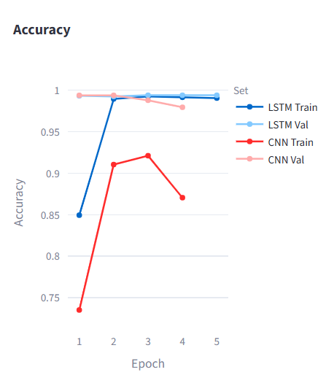
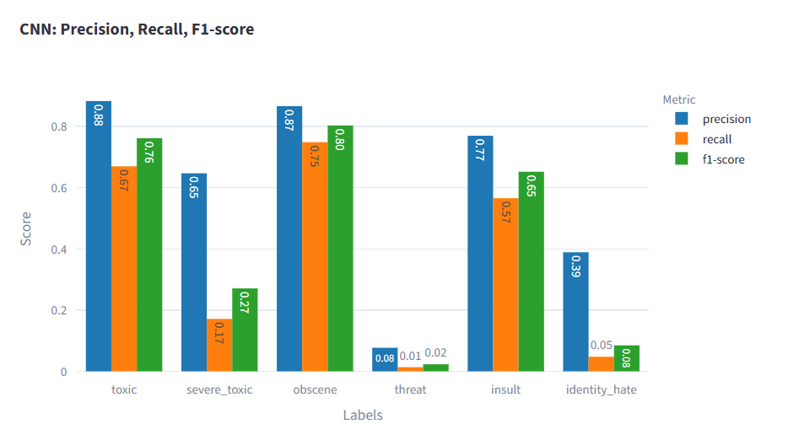
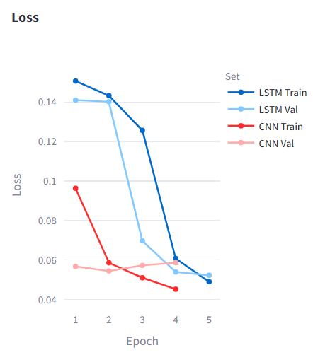
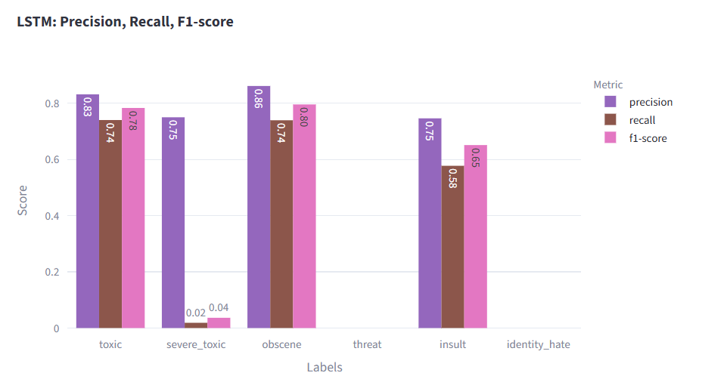
MODEL EVALUTION & COMPARISON

Slide 8
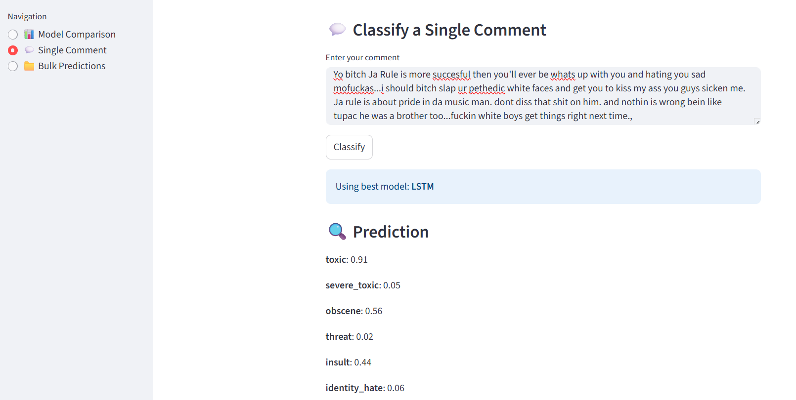
Deployment – Streamlit App

Slide 9
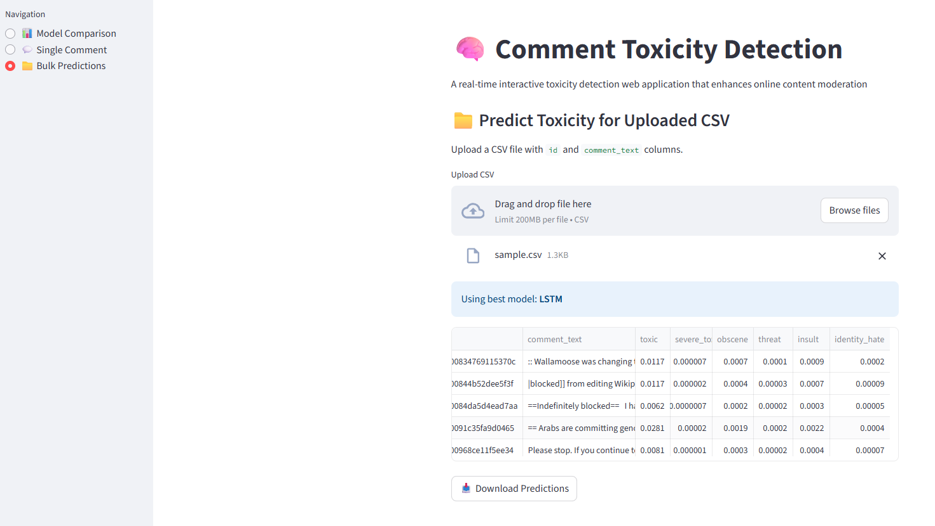
Deployment – Streamlit App

Slide 10
THANK YOU

